Slide 1
Lecture 12: Interpreting Hypothesis Testing Results (Type I Error and Power)
Jibo He, Ph.D.
Associate Professor
Wichita State University
jibo.he@Wichita.edu

Slide 2
Homework 4, Question 12
Suppose all of the third graders at Wilson Elementary School take a math test. The scores are normally distributed with μ = 75 and σ = 12.
What proportion of third graders scored higher than 90?
If you randomly select a third grader from Wilson Elementary School, what is the probability that the selected child scored higher than 90 on the math test?
In this case, third graders’ score is a random variable.

Slide 3
Homework 4, Question 13
Suppose you have a set of scores that are normally distributed with μ = 150 and σ = 30.
What is the standard error of the mean for samples of size 25?
If you randomly select a sample of 25 scores from the distribution, what is the probability that the sample will have a mean greater than 165?
In this case, sample mean is a random variable.

Slide 4
Outcomes of hypothesis testing: decision errors

Slide 5
A statistical hypothesis may be true or false (true state of nature), and performing a hypothesis test we may reject or fail to reject the null hypothesis. This leads to four possible outcomes, which we represent in the table below.
 | Actual Situation
My Decision | Null is True | Null is False
Accept the Null
Reject the Null

Slide 6
Conditional Probability of decision outcomes, that is, the probability of the hypothesis testing decision given the true state of nature (which is unknown): P(Hypothesis Testing Decision | Actual situation)
 | Actual Situation
My Decision | Null is True | Null is False
Accept the Null | Correct | Type II Error
Reject the Null | Type I Error | Correct

Slide 7
Type I and II errors
A type I error occurs when the null hypothesis (H0) is true, but is rejected. It is asserting something that is absent, a false hit. A type I error may be likened to a so-called false positive (a result that indicates that a given condition is present when it actually is not present).
A type II error occurs when the null hypothesis is false, but erroneously fails to be rejected. It is failing to assert what is present, a miss. A type II error may be compared with a so-called false negative (where an actual 'hit' was disregarded by the test and seen as a 'miss') in a test checking for a single condition with a definitive result of true or false. A Type II error is committed when we fail to believe a true alternative hypothesis.
The type I error rate or significance level is the probability of rejecting the null hypothesis given that it is true. It is denoted by the Greek letter α (alpha) and is also called the alpha level. Often, the significance level is set to 0.05 (5%), implying that it is acceptable to have a 5% probability of incorrectly rejecting the null hypothesis.
The rate of the type II error is denoted by the Greek letter β (beta) and related to the power of a test (which equals 1−β).

Slide 8
Statistical Decisions
Decisions we can make concerning the null
α: Alpha is the proportion of times I am willing to reject the null hypothesis, when that null was in fact true
Known as a Type I error (equal to the significance level)
1 – α : Proportion of times I am willing to retain the null hypothesis, when that null was in fact true
Correct Decision
Notes:
Alpha is also known as “rejection level”, or “significance level”
Rejection Region
Area of the sampling distribution where we feel confident enough to reject the Null
Use critical α to identify region
Implications of Rejection
Deterministic versus probabilistic
Obtain evidence for/against null

Slide 9
Statistical Decisions
β: Beta is the proportion of times I am willing to retain the null hypothesis, when that null was in fact false
Known as a Type II error
1 – β : Proportion of times I am willing to reject the null hypothesis, when that null was in fact false
Known as Power (Correct Decision)

Slide 10
Statistical Decision Table
 | Actual Situation
My Decision | Null is True | Null is False
Accept the Null | Correct 1 – α | Type II Error β
Reject the Null | Type I Error α | Correct 1 – β Power

Slide 11
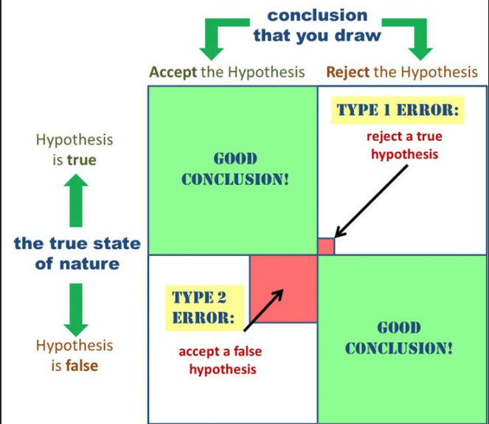
Type I and II errors

Slide 12
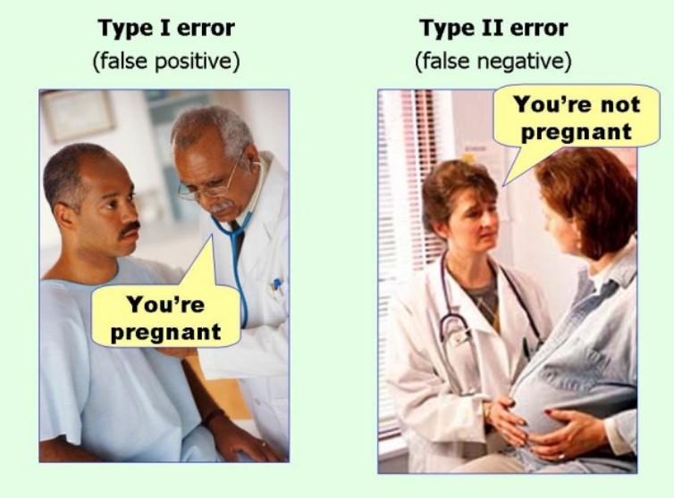
Type I and II errors

Slide 13
Relate the decision error to the area under the curve
We can also define these conditional probabilities in terms of areas under the null or non-null (alternative) sampling distributions:
α (the probability of Type I Error) = Pr (Reject H0 | H0 is true)
1- α (the probability of correctly retaining the null) = Pr (Retain H0 | H0 is true)

Slide 14
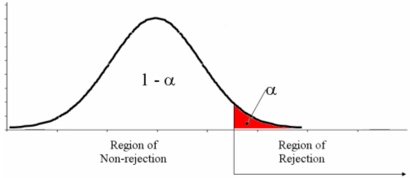
Conditional Probabilities
Suppose we are working with the hypotheses:
H₀ : μ ≤ 10 and H_{A} : μ > 10. We can depict α and 1- α as areas under the null sampling distribution of the test statistic:

Slide 15
Conditional Probabilities
β (the probability of Type II Error) = Pr (Retain H0 | H0 is false)
1- β (the probability of correct rejection of the null) = Pr (Reject H0 | H0 is false)
The Correct rejection of the null, 1 - β, is Power

Slide 16
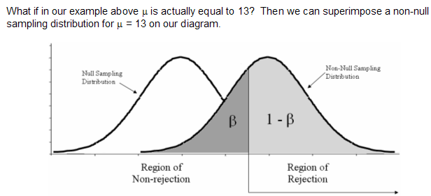
Conditional Probabilities

Slide 17
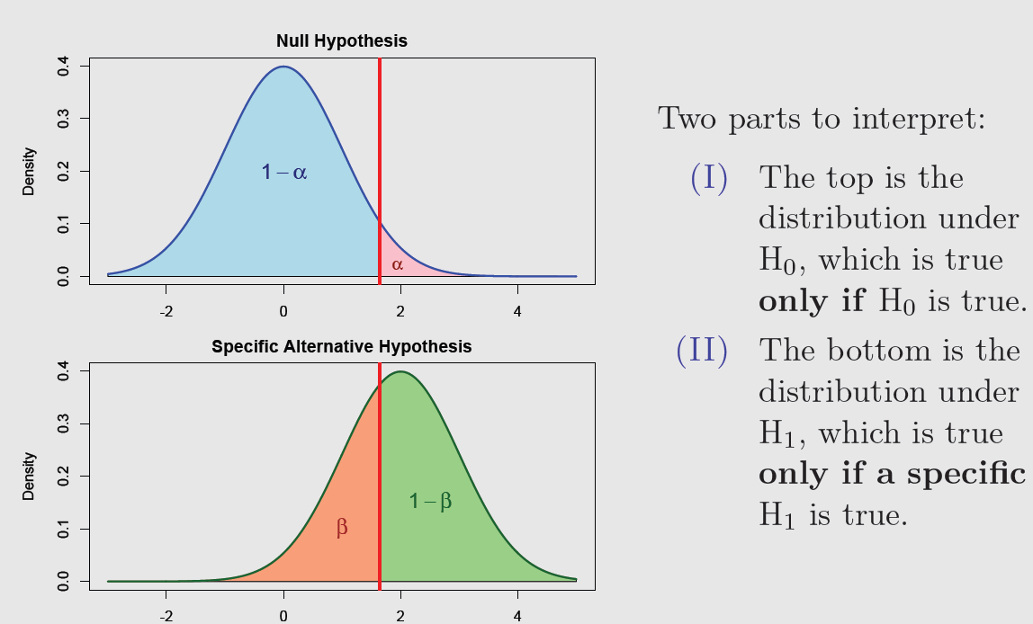
A Visualization of Decision Error

Slide 18
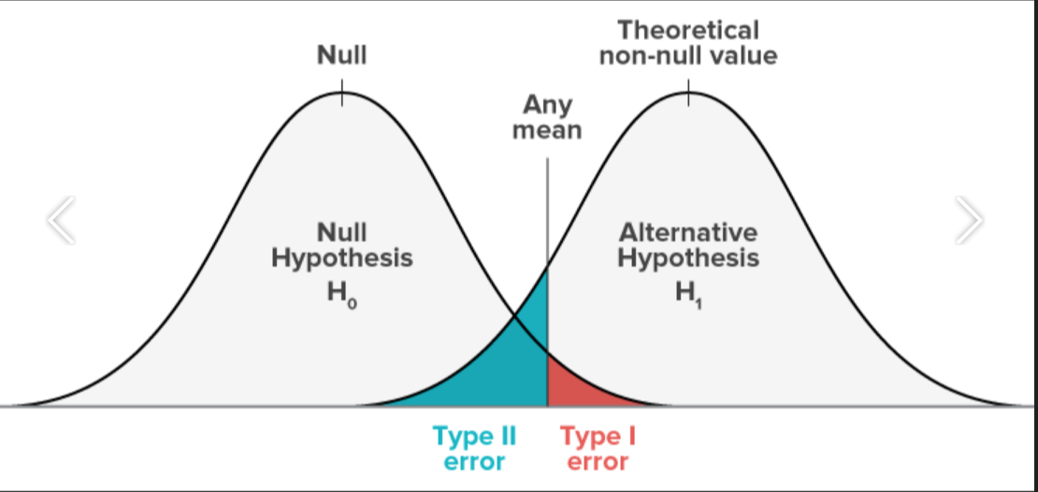
Type I and II errors

Slide 19
Effect Size and the Practical Importance of Results
Whenever we reject the null hypothesis, we say that there is a “statistically significant result.”
For example, if we are comparing the means of two groups and reject the null hypothesis that the means are equal, we may say that there is a statistically significant difference between the means.
This does not necessarily mean that the different is big!

Slide 20
Statistical significance vs. Practical significance
A statistically significant result is an obtained sample statistic that has a low probability of occurring by chance if H₀ is true (and thus H₀ is rejected).
A practically significant result is a difference that is large enough to be a meaningful difference in the real world.

Slide 21
Exercise
A researcher has spent several years measuring how long it takes rats to run through a particular maze. The researcher has concluded that rats take an average of 64.2 seconds to run the maze with a standard deviation of 6.3 seconds. The researcher wants to determine whether placing food at the end of the maze will decrease the amount of time it takes for rats to finish. He finds that a sample of 30 rats takes an average of 51.7 seconds to run the maze when there is food placed at the end. At a significance level of .05, do rats finish the maze faster when food is placed at the end?
State in words what a Type I and Type II error would be.

Slide 22
Answer
H₀: The sample was drawn from a population with μ ≥ 64.2.
H₁: The sample was drawn from a population with μ < 64.2.
Type I error: The researcher concludes that rats run the maze faster when there is food at the end, but in reality, rats do not run the maze faster when there is food at the end. Type II error: The researcher concludes that rats do not run the maze faster when there is food at the end, but they really do.

